Slide 1

Patient Monitoring using Activity Recognition
Aditya Bhat, Anirudh Negi, Gunjan Singh, Meghana Tumkur Narendra, Prashant Kanth, Parth Goel, Rishika Bhanushali, Shikha Vyaghra, Utkarsh Jha

Slide 2
Problem Definition & Motivation
Lack of monitoring causes health complications due to delayed response from medics.
Helping patients who can’t afford 24*7 nurse supervision due to economic restrictions
Our app focuses on:
continuous monitoring of patients
record their activities
alert health care providers in cases of emergencies (notify via call)
A final action summary report is also generated.
Notes:
There has been a lot of technical advancements in the healthcare system recently. But one exception could be patients still need to be always observed by nurse due to unpredictable complications and it comes at a higher cost which common people cannot afford. Our Motivation behind this project is to help patients who can’t afford 24*7 nurse supervision due to their economic restrictions. Our activity recognition app focuses on continuous monitoring of patients, record their activities and alert health care providers in case of any emergencies. It is also designed to immediately notify the respective medical authorities in times of emergencies. It will also release a final summary of the activities performed by patients and can be downloaded in the pdf format.

Slide 3

Literature Survey
SMART Frame Selection for Action Recognition
Selective Feature Compression for Efficient Activity Recognition Inference
OpenPose: Realtime Multi-Person 2D Pose Estimation using Part Affinity Fields
BlazePose: On-device Real-time Body Pose tracking
CNN-LSTM
Notes:
To begin with, we went through few of the papers related to action recognition to understand the ongoing work. We shall go over each paper one by one listed here.

Slide 4
SMART Frame Selection for Action Recognition
Action recognition is computationally expensive.
Previous work issues: considering all frames in a video at once, instead of individually, therefore making decisions globally.
The main goal of this paper is to address the problem of frame selection to improve the accuracy of action recognition.
Good frame selection can not only reduce the computational cost, but also increase the accuracy by getting rid of frames that are hard to classify.
Proposed method: SMART (Sampling through Multi-frame Attention and Relations in Time)
Notes:
Action recognition is computationally expensive. All the earlier work priorly was facing the issue of considering all frames in a video at once, instead of considering it individually, therefore it was making decisions globally. The main goal of this paper is to address the problem of frame selection to improve the accuracy of action recognition. In this work, the focus is on standard, short, trimmed action recognition problem and It has been shown that selecting good frames helps in that. The good frame selection can not only reduce the computational cost of action recognition but also increases the accuracy by getting rid of redundant frames that are hard to classify.
Authors have come up with a method that instead of selecting frames by considering one at a time, it considers them jointly. This results in a more efficient selection, where “good” frames are more effectively distributed over the video, like snapshots that tell a story. This method is named SMART (Sampling through Multi-frame Attention and Relations in Time). It is designed to use a small portion of the overall computational cost in selecting the best frames.

Slide 5
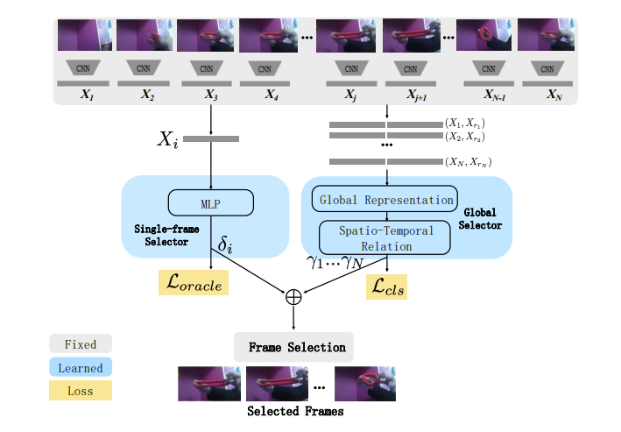
Overview of SMART frame selection
Notes:
Traditional models perform action recognition by average pooling predictions over a sequence of frames/clips.The proposed method SMART first determines the n most important frames and then action recognition is done by average pooling predictions over these frames.
Most existing frame selection methods look at a single frame at each timestamp. As a result, the selected frames tend to represent only a part of the action. But the SMART model not only considers the discriminative value of a single frame, but also considers its relation to others in a video. These frames will then be classified using a more computationally expensive model.

Slide 6
what SMART method achieved?
Reduces computational costs in comparison to full video by upto 4 times.
Outperforms recent frame selection approaches on untrimmed videos in accuracy.
Outperforms the recent state-of-the-art on multiple datasets.
Notes:
Finally, Authors have experimented this method on various datasets and have shown that the SMART frame selection method consistently improves the accuracy compared to other frame selection strategies. It has also reduced the computational cost by up to 4 times. Additionally, they have shown that this can be extended as a pre-processing step to obtain state-of-the-art accuracy on 2 benchmarks (UCF101 and HMDB51).
Next paper will be explained by gunjan

Slide 7
II. Selective Feature Compression for Efficient Activity Recognition Inference
This paper focuses on creating an efficient way to recognize actions from the clips/videos.
3D CNNs have been widely used for action recognition
Dense sampling works over the clips to classify action label, but inefficient.
Implementation of SFC: Selected Feature Compression
Action recognition inference strategy
SFC looks at the long video sequences and compresses the rich information of their frames into a much smaller representation, which is then given to 3D network that predicts the corresponding action label.

Slide 8
How SFC works?
Pre-trained 3D network is splitted into two components, head and tail.
Insertion of the SFC between head and tail networks.
SFC compresses the internal spatial-temporal representations from the head network .
TopK Pooling approach is applied to downsample the features
This compressed representation is passed to the tail network, which now operates on a much smaller input.
This design brings the additional benefit of not needing to retrain the action network, as SFC can be fine tuned independently and very quickly.

Slide 9
SFC is designed in such a way that:
remove redundant information while preserving useful parts of the video directly at the feature level
reduce the inference computation of the tail network by compressing the feature
Various experiments and results were presented in the paper which concluded that SFC is able to reduce inference speed by 6-7x and memory usage by 5-6x compared with the commonly used dense sampling procedure.

Slide 10
III. OpenPose: Realtime Multi-Person 2D Pose Estimation using Part Affinity Fields
Proposed method for 2D human pose estimation uses a nonparametric representation(Part Afﬁnity Fields (PAFs)) to learn to associate body parts with individuals in the image.
Bottom-up system achieves high accuracy and realtime performance, regardless of the number of people in the image.
PAF-only reﬁnement: l increase in both runtime performance and accuracy by approximately 200% and 7%, respectively
Combined body and foot keypoint detector
Generality of their method by applying it to the task of vehicle keypoint estimation
Notes:
In order to monitor a patient/person the main thing that we needed was 2D human pose estimation in any video. We referred many papers, who have done research for Realtime 2D pose estimation. One of the paper is OpenPose: Realtime Multi-Person 2D Pose Estimation using Part Afﬁnity Fields.The proposed method in this paper uses a nonparametric representation, which they refer as Part Afﬁnity Fields (PAFs), to learn to associate body parts with individuals in the image.
There are two types of approaches for 2d human pose estimation Top down approach that is to first obtain human candidates by a human detector, and then perform single- person pose estimation. This method has disadvantage that their runtime is proportional to the number of people in the image. Another one is bottom up approach di- rectly predict the keypoints all at once, and then assemble them into the full poses for all persons having advantage of early commitment and to decouple runtime complexity from the number of people in the image.
This is a bottom-up system that achieves high accuracy and realtime performance, regardless of the number of people in the image. In addition to that this paper mainly focuses on Inferring the pose of multiple people in images or videos.
In previous work, PAFs and body part location estimation were reﬁned simultaneously across training stages. In this paper they have demonstrated that a PAF-only reﬁnement results in a substantial increase in both runtime performance and Memory accuracy by approximately 200% and 7%, respectively.
They have also presented ﬁrst combined body and foot keypoint detector, based on an internal annotated foot dataset that reduces the inference time maintaining the accuracy of each component.
In this paper they have also demonstrated the generality of their method by applying it to the task of vehicle keypoint estimation

Slide 11
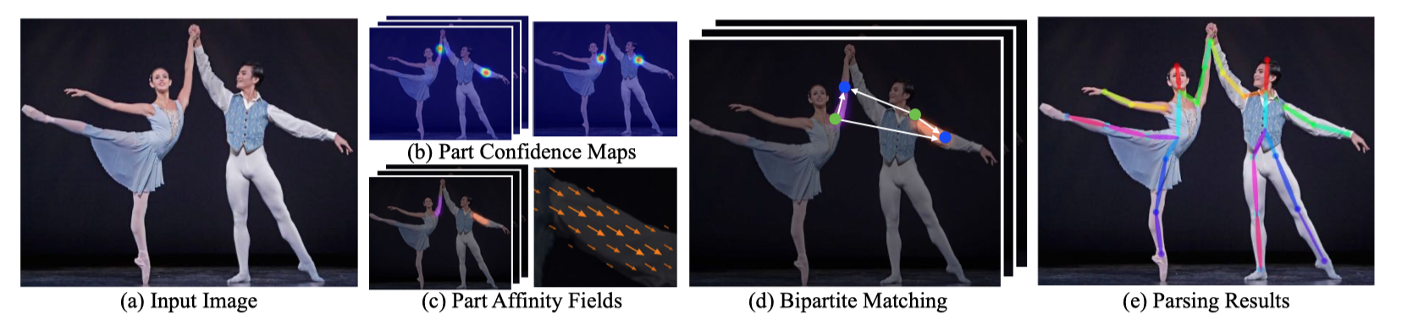
How does proposed method works
Notes:
(a) Our method takes the entire image as the input for a CNN to jointly predict (b) then produce the conﬁdence maps for body part detection and (c) and PAFs for part association. (d) The parsing step performs a set of bipartite matchings to associate body part candidates. (e) Then We ﬁnally assemble them into full body poses for all people in the image.

Slide 12
Open Pose Library
First real-time multiperson system to jointly detect human body, foot, hand, and facial keypoints
Can run on different platforms, including Ubuntu, Windows, Mac OSX, and embedded systems
Provides support for different hardware, such as CUDA GPUs, OpenCL GPUs, and CPUonly devices
User can select whether to display the results or save them on disk, enable or disable each detector (body, foot, face, and hand), enable pixel coordinate normalization, control how many GPUs to use, skip frames for a faster processing, etc.
OpenPose consists of three different blocks: (a) body+foot detection, (b) hand detection, and (c) face detection.
Notes:
This is ﬁrst real-time multiperson system to jointly detect human body, foot, hand, and facial keypoints (in total 135 keypoints) on single image.
It can run on different platforms, including Ubuntu, Windows, Mac OSX, and embedded systems (e.g., Nvidia Tegra TX2).
It also provides support for different hardware, such as CUDA GPUs, OpenCL GPUs, and CPUonly devices
The user can select an input between images, video, webcam, and IP camera streaming. He can also select whether to display the results or save them on disk, enable or disable each detector (body, foot, face, and hand), enable pixel coordinate normalization, control how many GPUs to use, skip frames for a faster processing, etc that are advantages over other 2D body pose estimation libraries such as Mask R-CNN or Alpha-Pose.

Slide 13
Takeaways from this paper
Present an explicit nonparametric representation of the keypoint association that encodes both position and orientation of human limbs
An architecture that jointly learns part detection and association.
Demonstrates that a greedy parsing algorithm is sufﬁcient to produce high-quality parses of body poses, and preserves efﬁciency regardless of the number of people
PAF reﬁnement is far more important than combined PAF and body part location reﬁnement
Combining body and foot estimation into a single model boosts the accuracy of each component individually and reduces the inference time of running them sequentially.
Notes:
The author have testted this method on various datasets and reached to following conclusions:
In this paper, they presented an explicit nonparametric representation of the keypoint association that encodes both position and orientation of human limbs.
Second, they design an architecture that jointly learns part detection and association.
Third, they demonstrated that a greedy parsing algorithm is sufﬁcient to produce high-quality parses of body poses, and preserves efﬁciency regardless of the number of people.
Fourth, they proved that PAF reﬁnement is far more important than combined PAF and body part location reﬁnement, leading to a substantial increase in both runtime performance and accuracy.
Fifth, they show that combining body and foot estimation into a single model boosts the accuracy of each component individually and reduces the inference time of running them sequentially.

Slide 14
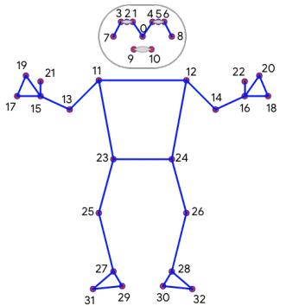
IV. BlazePose
Lightweight Convolutional network for real time pose estimation on mobile devices.
Types of approaches for Human pose estimation
Heatmap Based approach
Regression based approach
Presented a new topology - (33 keypoints)
Better than OpenPose
Notes:
In this paper, authors present a lightweight convolutional network architecture for human pose estimation specially tailored for real time inferences on mobile devices. There are two approaches for human pose estimation. First one is the heatmap based approach, where heatmaps are produced for each joint. This might seem a good pick for models having multiple person detection, but is too big for a model having a single person to detect. The authors have worked on developing a good model for this use case. The second approach is the regression based approach which is less computationally demanding and more scalable, but often failing to address the underlying ambiguity. The authors have chosen best of both worlds for this model. They have used an encoder-decoder network architecture to predict heatmaps for all joints, followed by another encoder that regresses directly to the coordinates of all joints. The key insight behind our work is that the heatmap branch can be discarded during inference, making it sufficiently lightweight to run on a mobile phone. The authors present a new network topology using 33 keypoints by taking the superset of those used by BlazeFace, BlazePalm Coco dataset. But in contrast with these ones, we use only a minimally sufficient number of keypoints on the face, hands, and feet to estimate rotation, size, and position of the region of interest for the subsequent model. This is the network topology they used.

Slide 15
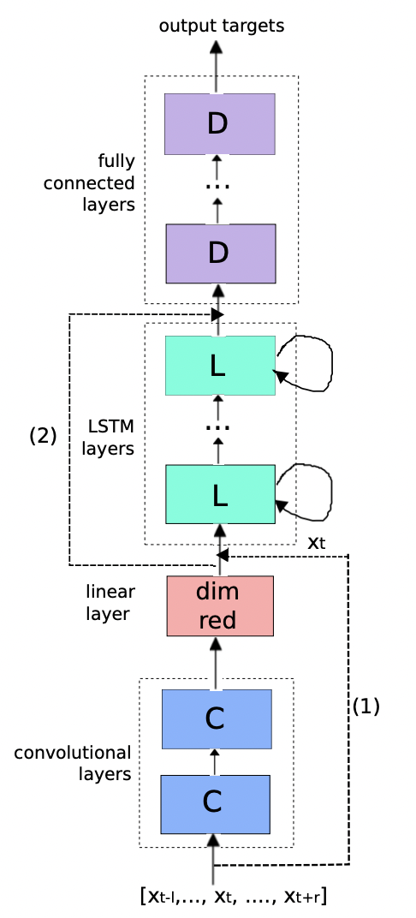
V. CONVOLUTIONAL, LONG SHORT-TERM MEMORY, FULLY CONNECTED DEEP NEURAL NETWORKS
CNNs reducing frequency variations
LSTMs temporal modeling
DNNs mapping features to a more separable space
CLDNNs gave good results for our project
Notes:
CNNs, LSTMs and DNNs are complementary in their modeling capabilities, as CNNs are good at reducing frequency variations, LSTMs are good at temporal modeling, and DNNs are appropriate for mapping features to a more separable space. In this paper, we take advantage of the complementarity of CNNs, LSTMs and DNNs by combining them into one unified architecture. The authors have tested this combined archiechture over a large variety of vocabulary tasks and found out that the results which they obtained were atleast 4-6% better than the conventional LSTMS. The model we propose is to feed input features, surrounded by temporal context, into a few CNN layers to reduce spectral variation. The output of the CNN layer is then fed into a few LSTM layers to reduce temporal variations. Then, the output of the last LSTM layer is fed to a few fully connected DNN layers, which transform the features into a space that makes that output easier to classify. We have used this architecture in our project and would like to explain it further in our later slides. Now, Utkarsh will go over the Proposed approach

Slide 16
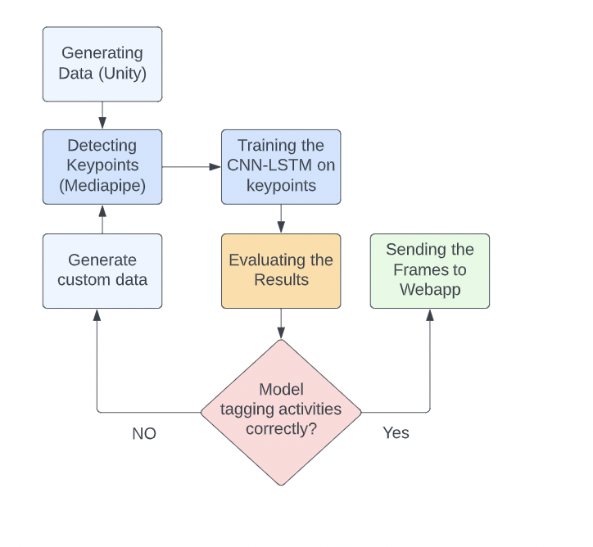
Proposed Approach
Notes:
The Data we wanted to use is obscure and hence we had to generate synthetic data using Unity 3d . This data was then sent to the mediapipe which is a wrapper to BlazePose model which gives us the keypoints of skeletal features of the person in frame.. The CNN-LSTM model was trained on these keypoints and the results were evaluated. Once the model was tested several times and it gave good results, we finalized it.

Slide 17




DataSet Preprocessing/ Feature Extraction
Collected multiple characters and animations from mixamo
Imported characters in Unity 3D and generated simulations through C# script
Used mediapipe (blaze pose) to extract human keypoints
Notes:
Speaking about out data preprocessing, we collected several characters from mixamo by Adobe and imported them to Unity 3d to generate the simulations through a script. For the keypoint extraction part, we used mediapipe.

Slide 18
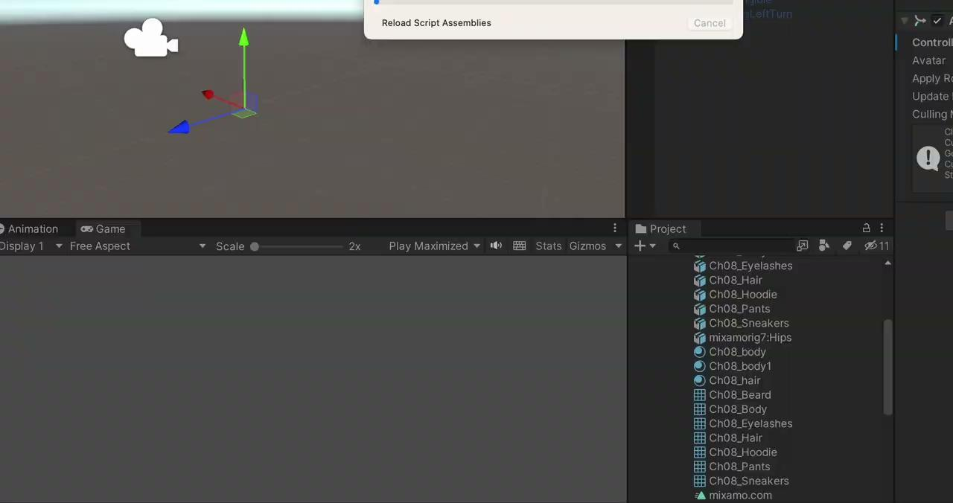
Dataset Simulations
Notes:
We also collected data from multiple angles and other augmentation techniques such as zoom in out , horizontal camera translation. Apart from these samples, we have multiple other characters and types of animation for same action. . Now Prashant would talk about DataSet Preprocessing/ Feature Extraction

Slide 19
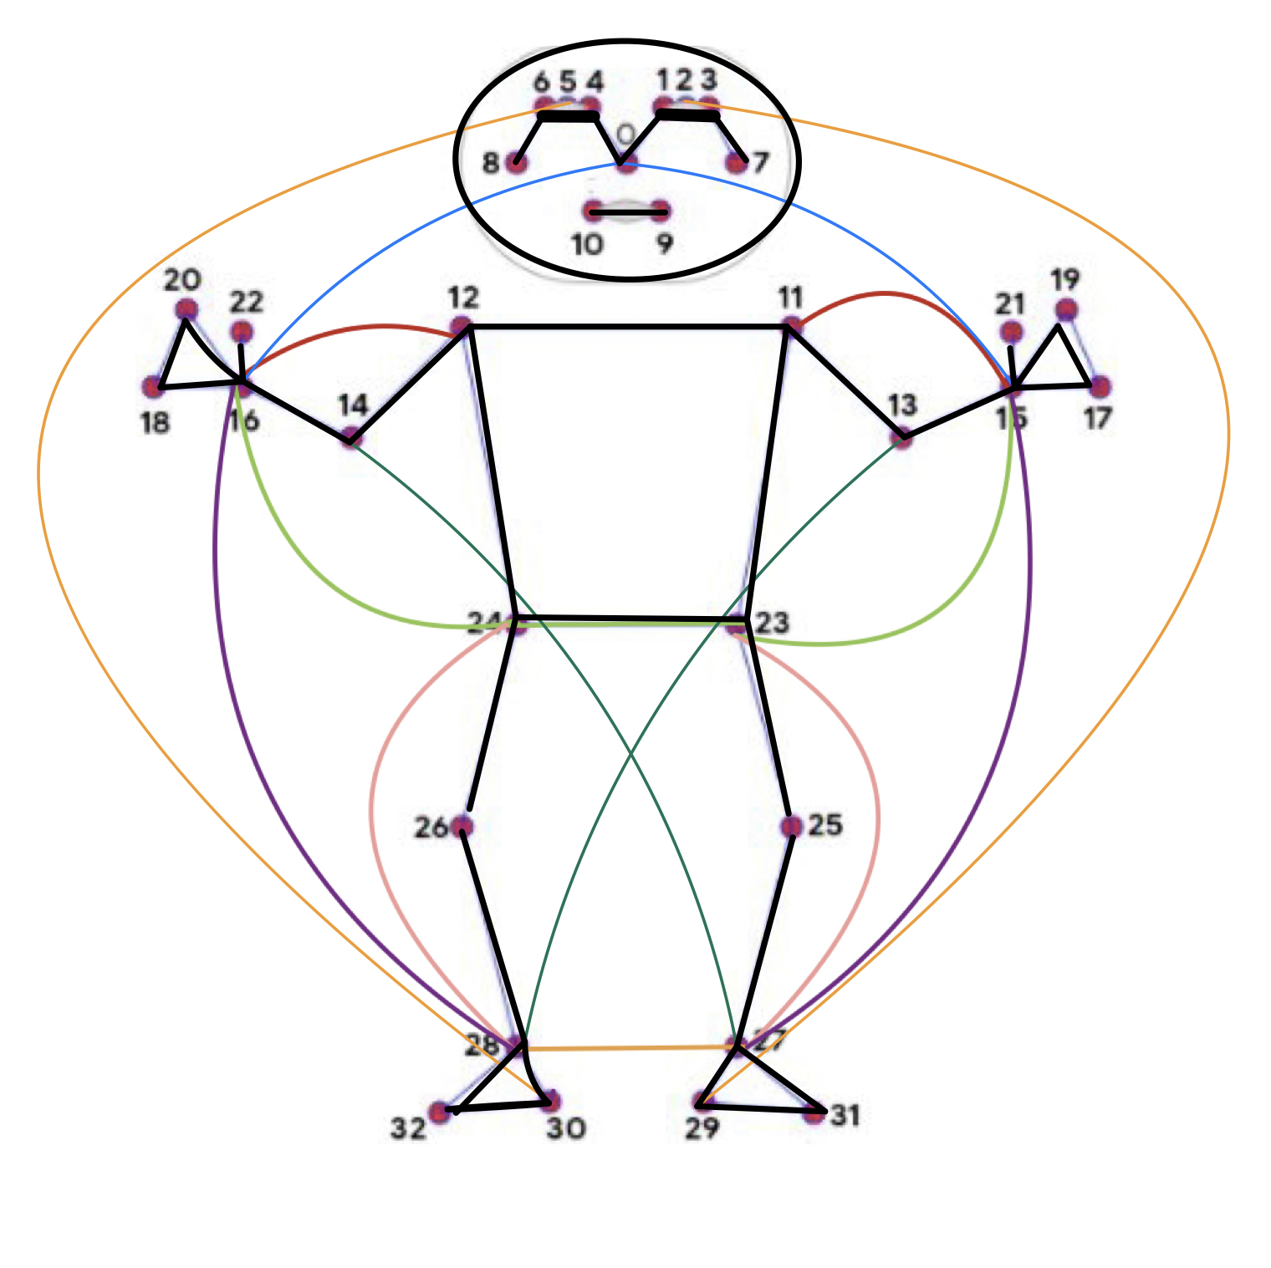
DataSet Preprocessing/ Feature Extraction
33 keypoints, 3d coordinates (x, y, z)
Computed distance between selected keypoints (19 distances) for additional features
Few examples:
Nose(0) to Wrist(15, 16)
Hip(23, 24) to Ankle(26, 27)
Hip(23, 24) to Wrist(15, 16)
118 dimensional feature vector per frame

Slide 20
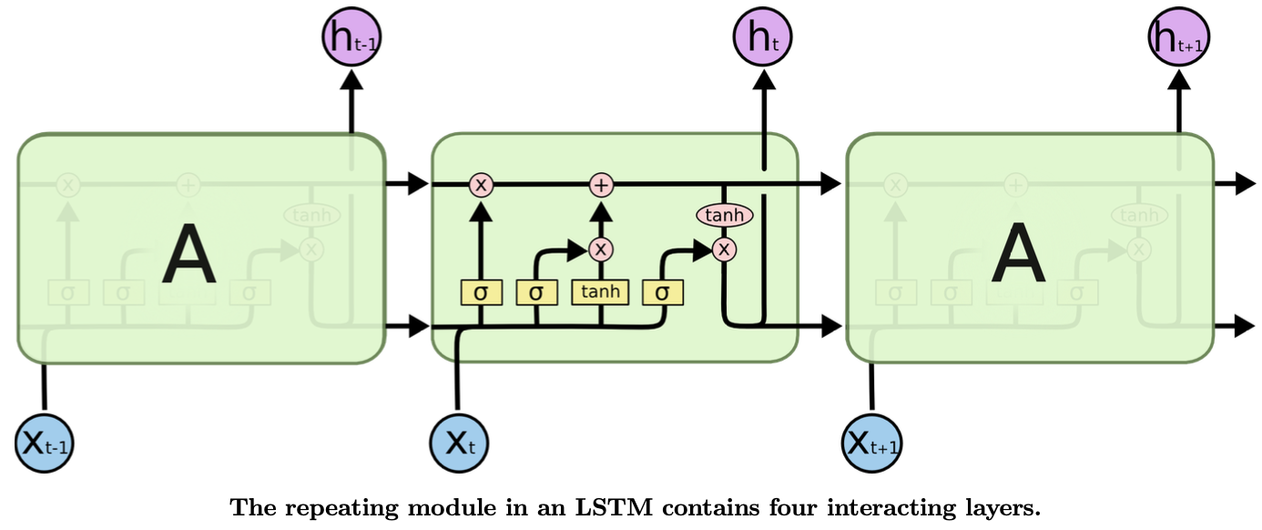
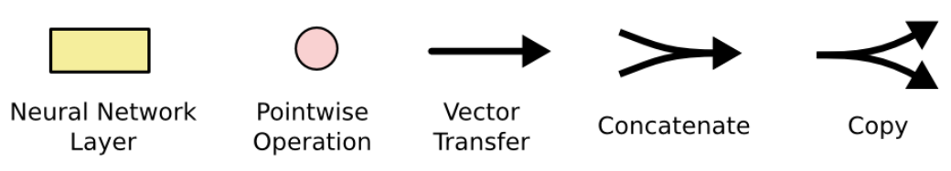
What is LSTM (Long Short Term Memory)?
Special kind of RNN, capable of learning long-term dependencies
States
Cell State (c_{t-1})
Hidden State (h_{t-1})
Gates
Forget Gate (Sigmoid)
Update Gate (Sigmoid and Tanh)
Output Gate (Sigmoid and Tanh)
Source: https://colah.github.io/posts/2015-08-Understanding-LSTMs/
Notes:
cell state: Cell states give the model longer memory of past events, enabled by: the storage of useful beliefs from new inputs
hidden state: Working memory capability that carries information from immediately previous events and overwrites at every step

Slide 21
What is CNN-LSTM ?
Special kind of LSTM, consisting of CNN layers for feature extraction on input data combined with LSTMs to support sequence prediction.
CNN LSTMs were developed for visual time series prediction problems and the application of generating textual descriptions form sequences of images (e.g. videos). Specifically activity, image and video recognition
Notes:
We have used CNN-LSTM for our project, which is a special kind of LSTM, consisting of CNN layers for feature extraction on input data combined with LSTMs to support sequence prediction. CNN-LSTMs were developed for visual time series prediction problems and the application of generating textual descriptions from sequences of images (eg videos). It works particularly well for activity, image and video recognition.
One issue with LSTMs was that the temporal modeling is done on the input feature xt. However, higher-level modeling of xt can help to disentangle underlying factors of variation within the input, which should then make it easier to learn temporal structure between successive time steps. For example, it had been shown that CNNs learn speaker-adapted/discriminatively trained features, and thus remove variation in the input. Thus, it is beneficial to proceed LSTMs with a few fully connected CNN layers.
In terms of model architecture and input, as we know that LSTMs take 3 dimensional data in which the dimensions are [samples, time steps, features], CNN-LSTMs take 4 dimensional data in which the dimensions are [samples, n_steps, n_length, features], where n_steps means the number of steps we want to divide our timestep in, and n_length means the length of the timestep after dividing it in steps. So basically n_steps * n_length = time steps.

Slide 22
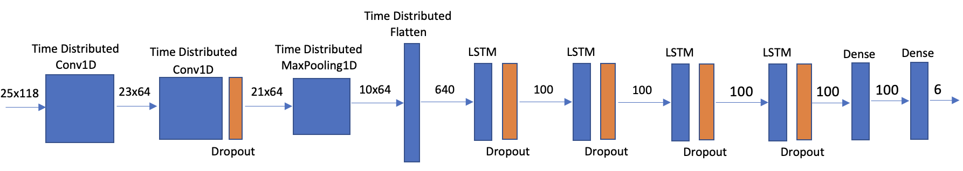
Network Architecture
Notes:
This is the network architecture we have used to train our model. As you can see we have 2 Time Distributed Conv1D layers followed by Time Dstributed MaxPooling1D and Flatten layers, followed by 4 LSTM layers of 100 units each and dropout layers with 0.5 percent drop rate. Finally we have 2 dense layers which shape the output to 6 which is the number of activities we want to classify.

Slide 23
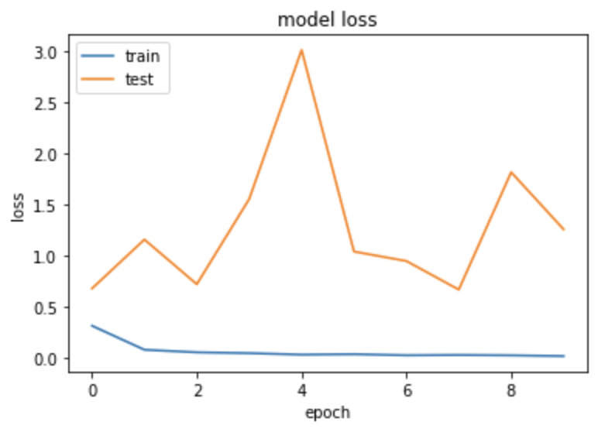
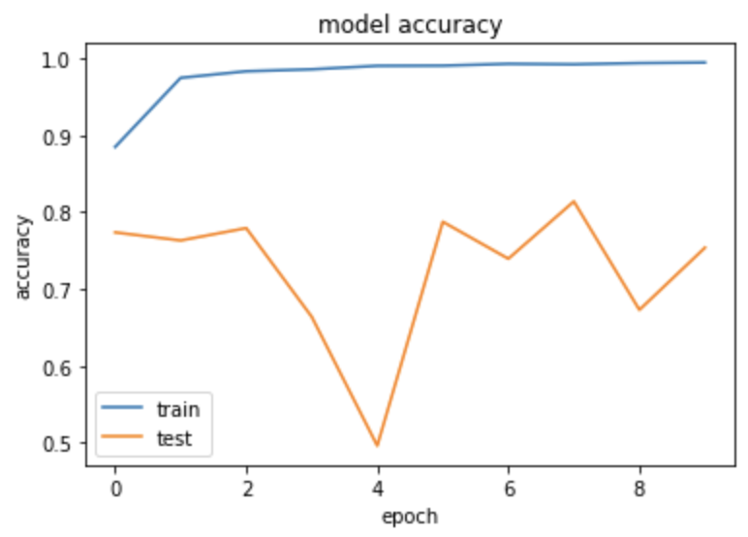
Model Performance
Notes:
These are the model performance graphs. On the left we have the model accuracy, as we can see that the training accuracy is consistently increasing and as for validation accuracy except for epoch 4 it is quite consistent at around 75-80 precent. On the right we have model loss, here we can see as well that the training loss is consistently decreasing and as for the validation loss except for epoch 4 is consistent at around 1.

Slide 24
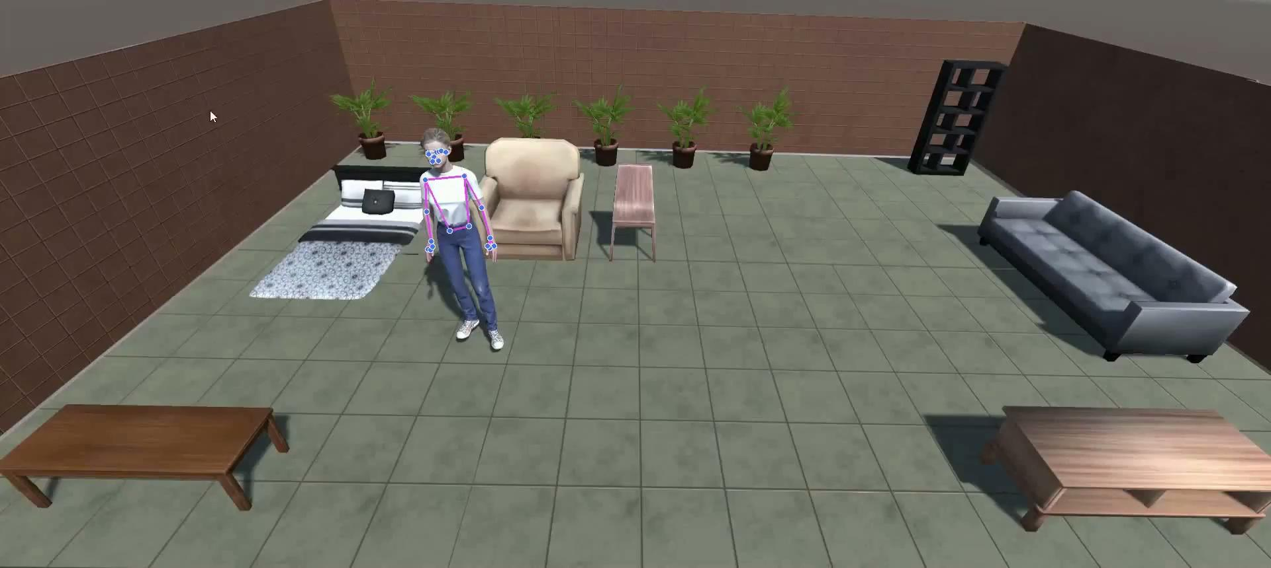
Results
Notes:
Here is a sample result video for testing our model on simulated data. As you can see it makes some errors but still it performs quite well for majority of time.

Slide 25
Experiments
Performed multiple experiments with different features and network architectures:
Different Features experimented:
2 dimensional feature, 33 keypoints on both x and y axis. Making a total of 66 features.
Included the z axis as well to get the depth affect, giving 33 * 3 = 99 features.
Pose Normalized keypoints. 𝛍: hip center, 𝞼: farthest keypoint from hip center, Features: distances between 17 pairs of keypoints (Scale Invariant and motion sensitive features)
Finally, added 19 distances between different keypoints to these 99 features giving a total of 118 features.
Notes:
Calculated distances as difference between 17 different pairs of keypoints to be passed as features (51 dimensional vector)
The intuition being that these features will be height invariant and provide better information about activities as distance between keypoints changes on movement and remain static otherwise.

Slide 26
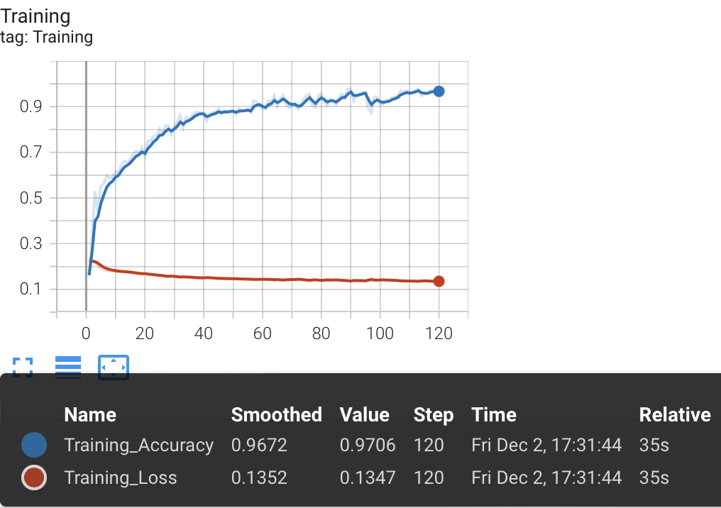
Experiments
Different Architectures experimented:
LSTM: 2 layers, hidden state dimensions: 128, learning rate: 2e-4 decayed by 0.5 every 50 epochs for 120 epochs, Dropout (0.5)
Linear layer with Softmax Activation as Output for 6 classes
Limitation:
Inconsistent validation results for standing/walking, sleeping/falling.
Low generalization.
Notes:
Calculated distances as difference between 17 different pairs of keypoints to be passed as features (51 dimensional vector)
The intuition being that these features will be height invariant and provide better information about activities as distance between keypoints changes on movement and remain static otherwise.

Slide 27
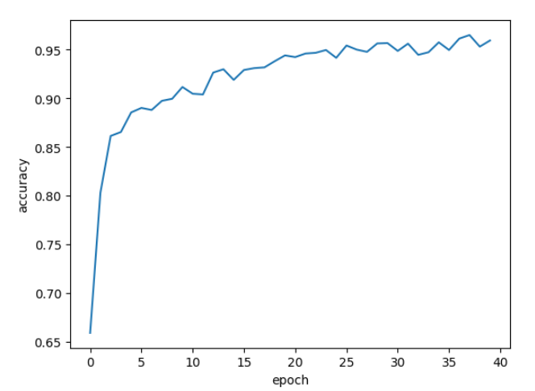
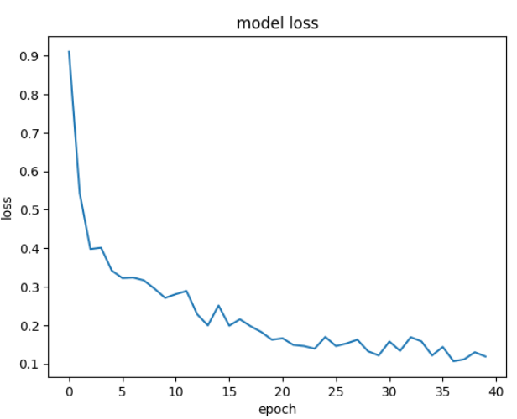
Experiments
Different Architectures experimented:
LSTM: 3 hidden layers with 500, 100 and 50 ‘units’, Dropout (0.5), dense layer with 64 hidden state dimensions
Linear Layer with Softmax Activation as Output for 6 classes
Limitation:
More transition inconsistency.
More mis-classification.

Slide 28
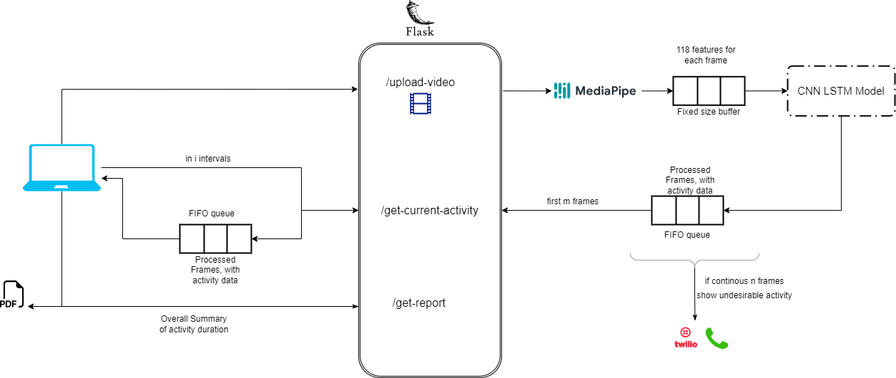
Technical Approach (cont.)
Notes:
Thanks Prashant, So I'll talk about the detailed technical approach that we used in our project.
1.
The user uploads a video via upload-video api and receives success message after the video captured into the server.
The server starts processing the video asynchronously, then each frame in the video is passed to
the mediapipe model which we use for body keypoints detection. This model gives us 33 body key points with x,y,and z coordinates, so in total 99 features, additionaly, we combine them with 19 custom features which we calculate based on distance between different keypoints as described previously and then store these 118 features for each frame in a buffer of size n (in our case 25) once the buffer is full, these
118 features of last 25 frames are passed as input to the CNN LSTM model, which classifies the activity of the current frame.
Now, we store this classfied activity info and the processed frame in a queue. the frame is converted into bytes to easily tranfer over http protocol.
2.
The get-current-activity api is called every s seconds (in our case 2 seconds), the api pops first f non-empty elements (in our case 60) from the the fifo queue that we have on server side and app puts them into fifo queue on front-end side.
and then these frames are stiched together to form a processed video along with the activity info which is displayed
in our application
3.
now while each frame is processed, we also keep track of history of activities of each frame in
a dataframe, which is then aggregated to give the duration of each activity as part of get-report api which then be downloaded as a pdf.
during the processing of activity recognition, if consecutive x frames(in our case 40) show undesirable activity, like cough/ pain or falling, we use the twilio api, through which the nurse / attendent gets a call that the patient needs help
Now, Aditya will be sharing a demo for this project.

Slide 29


Slide 30
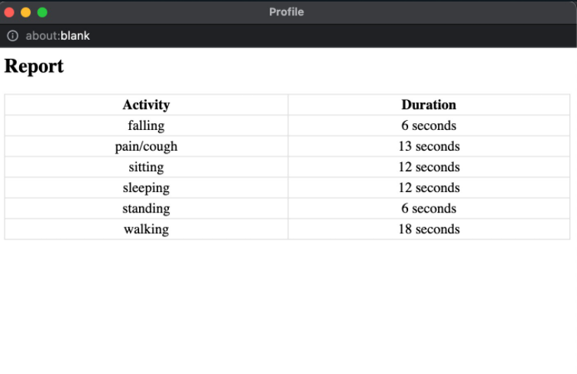
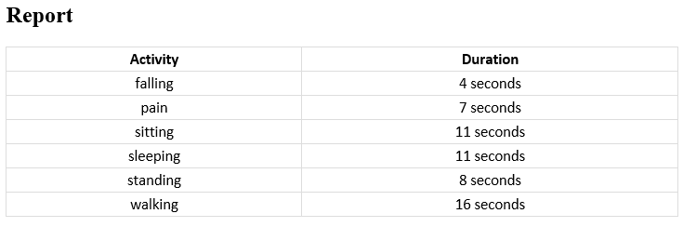
Results
Model Generated Report
Ground Truth Report

Slide 31
Conclusion
Future Work
We were successfully able to predict abnormal activities i.e, pain,cough and falling but faced inconsistencies in walking and standing.
Some misclassifications occur during activity transition.
We can add more normal and abnormal activities so as to imitate more human actions.
Introducing a person detection model (yolov5 or mask-rcnn) and pass only the bbox of the person to keypoint detection model.
Therefore the problem boils down to static-type and movement-based activities

Slide 32
Learnings
Synthetic Data Creation in Unity 3D
Data Engineering and Feature Extraction
Experimentation with LSTMs:
Bi-directional LSTMs
GRUs including Bi-directional GRUs
CNN-LSTM
Takeaways
Quality over Quantity

Slide 33


